Slide 1
Tech Dev Firm – Marketing brainstorm
GOAL: Define targeting (clients and talent), core identity discussion (WHO, WHAT, VALUES)

Slide 2
targeting
Identify key targets – clients and talent – to understand WHO we’re targeting

Slide 3
BASIC TARGETING
Sergio review, edit and confirm
Your ideal client (company)
Software development firms. Azure clients first, then other Cloud platforms (AWS & GCP)
$5-$50M revenue (we believe that smaller companies will need our services even more as they won't know how to recruit/hire people in LATAM
Characteristics
Top partners of MSFT, AWS, GCP looking to extend current NA team
Don’t have networks, don’t have vision or ability to do this on their own
Industries they target are entertainment, CPG, retail, life sciences (soft industries are faster movers to the cloud - not O&G, IHT)
Alignment of values, culture
To grow/continue to grow, their cost will be linear if they use US resources only – we can offer more appealing rates
Examples (see notes)
Your ideal buyer(s)
CTO
Cost pressures – maintain costs during inflation, too heavily weighted to one tech – help grow other tech business for growth without investment
Evaluate us for risk into delivery process (will look for certifications, references)
Final approval
Industry/Technology BU Leaders
Tech BU lead for SW firms that have more than one technology
Industry BU focused on growth specific to projects (client needs tech they don’t support)
Notes:
Buyers – Top Partners for MSFT, AWS & GCP looking for an extension of their current NA team
Helping their clients transition from on-prem platforms to cloud-based solutions
$50M will have about 100 people
Over $50M will probably be working with recruiters – they will already have networks and resources
Above $50M if they have open positions in our regions – we can selectively approach to offer – staffing agency of choice for larger companies
Some examples of potential clients - https://clutch.co/it-services/cloud/azure-partners
https://www.emergentsoftware.net
https://www.itransition.com
https://www.techmd.com/it-services/cloud-solutions/
https://www.instil.co/what-we-do/

Slide 4
BASIC TARGETING
Sergio review, edit and confirm
Your ideal technical leader (BU/platform leader)
7-8 years technology experience in a specific platform
Patience and desire to mentor/develop/train resources so they can establish bootcamps, monitor performance/lead and grow high-performing teams
Able to coach clients and ask questions
IT-focused or development background
Passion for cloud computing – appreciation for fast-pace of change – critical thinking, looking for new and better ways to do things
Visionary – Intrapreneurs/entrepreneurs (build the house)
Your ideal technical developer
Self-management/independence
Focused on solving client problems
CS majors, 2-3 years of experience to start (first “class”), but then more recent grads
Current turmoil – talent being let go as startups fail
Currently in consulting firms doing “digital transformations” to migrate legacy solutions into cloud
Titles
Full-stack developer on X platform
Back end developer
Notes:
Talent – best technical developers with excellent self-management, critical thinking, decision making and interpersonal skills. We should look for people that have alignment with our values. Given the fast pace (faster than consulting) we don’t tolerate intellectual sloth
Looking for leaders in – MSFT, Amazon, Google, data science

Slide 5
Perception
Examine how perception of your industry is evolving over time to inform areas of alignment or differentiation (WHAT makes us different)

Slide 6
Industry perception
Sergio review, edit and confirm
Current Situation
What’s going on now for the industry? How do they feel about the challenges internally that have led them to need one?
Ideal Future
What is the future of staffing firms that you hope to bring about? How is it different from the past or today?
Previous Experiences
What experiences have people had with tech staffing firms? How is the industry perceived?
Seen as temporary jobs, seasonal
Low skill sets (janitorial, clerical) things with peaks and valleys
Question quality
Question loyalty
Consultancies pushing the bar up (middle and high management) Slalom
Good candidates demand very high compensation – need help to cover open positions
Current US resources can only cover 50% of current demand for dev talent (new technologies) scarce labor, high costs
Build a firm of top performers who want new challenges every day (new companies, cultures, industries)
Clients look for outcomes/things – not individual talent – teams embedded as part of client projects (workstream engagements)
Past
Present
Future
Notes:
People want an agency and opportunity to work in different types of projects

Slide 7
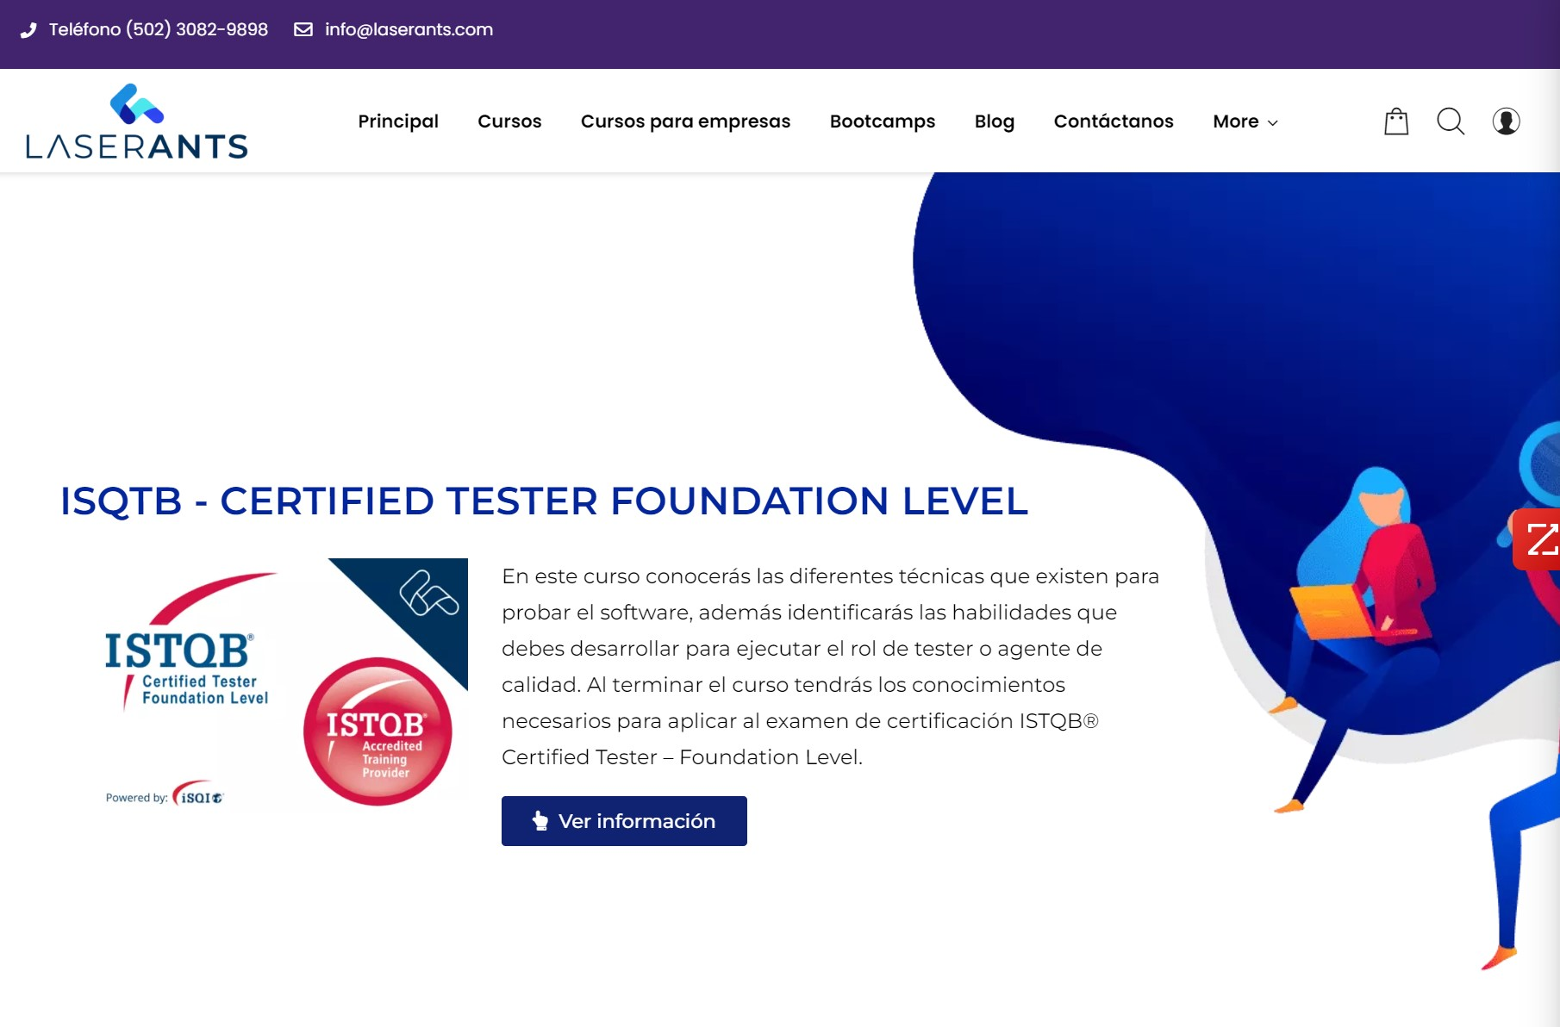
Competitive check - Laserants
Sergio review, edit and confirm
Observations:
Focused on courses/training
Bootcamps and development of full stack developers (front end training piece that we'll be doing)
Make connections to future employers
Don’t own resource
How we’re different:
We can learn from their bootcamp setup
Different business model
Notes:
What do we like/not like in this messaging/branding?
How are we different?

Slide 8
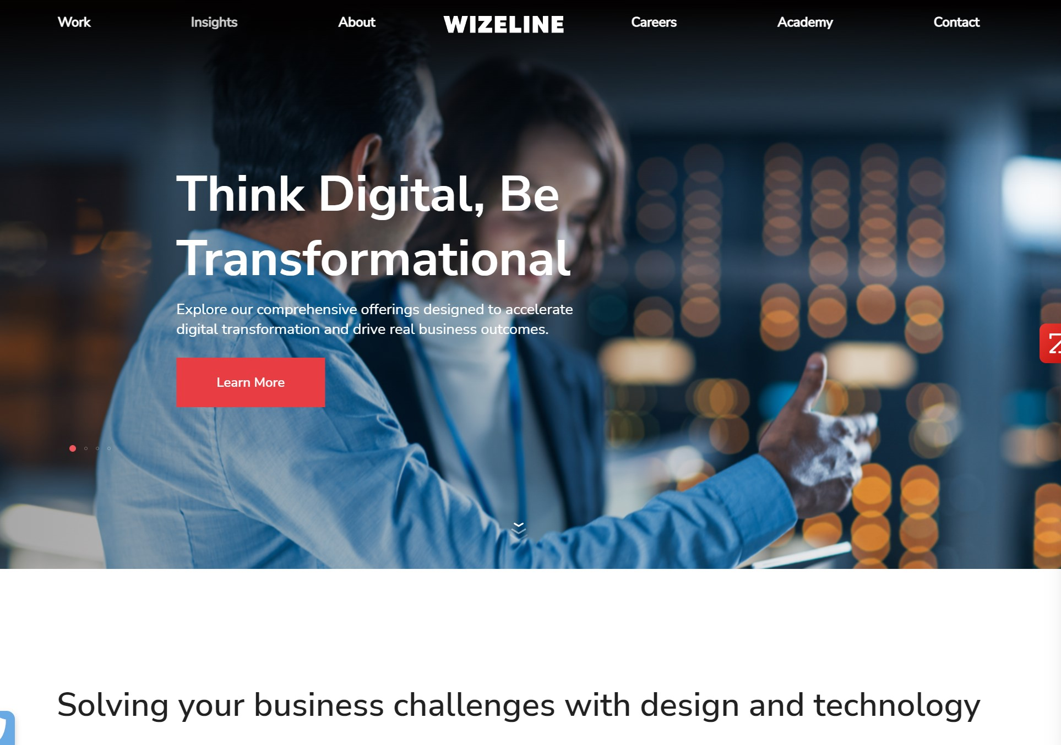
Competitive check - wizeline
Sergio review, edit and confirm
Observations:
Pure development firm
Has consulting arm to analyze client problem and develop solutions end-to-end
Strong social media presence
Mix of Mexican and American clients
We will compete with them for talent
How we’re different:
This is how we will evolve to offer consulting services to US clients
On-demand courses, bootcamps, women in tech offered to clients (not their own resources)
Attractive on salary, not on culture – work/life balance, friendly environment
Mentorship structure not there
Notes:
What do we like/not like in this messaging/branding?
How are we different?

Slide 9
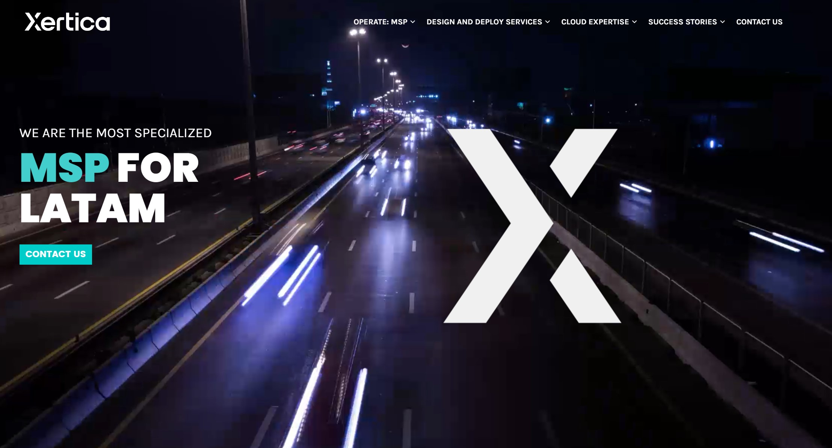
Competitive check - xertica
Sergio review, edit and confirm
Observations:
Services are similar to what we'd have
They have a services/consulting arm now which we wouldn't right now
Will compete for talent, not clients
How we’re different:
They are focused on LATAM clients
Sergio to check w Martin
Notes:
What do we like/not like in this messaging/branding?
How are we different?

Slide 10
Perception synthesis
Sergio review, edit and confirm
Why are we here?
Who are we here for?
What makes us different?
What do we value most?
To connect top technical talent with firms seeking rapid growth
To provide exciting opportunities to top technical talent
To provide a flexible / freelance-like work environment with the stability of a full-time job
Software firms seeking rapid growth without linear cost of adding expensive US-based employees
Top LATAM talent with a desire to rapidly grow while contributing to a fast-paced, exciting environment
Talent-centric
Culture-centric – we will be a talent magnet
We’ll provide a mentorship structure to enable talent development and growth for the long-term
Outcome-focused – not just here to drop in talent – oriented to solve strategic client problems
Focused on enabling and empowering women in tech
Scope - offer a combination of high quality bootcamps, certifications and staffing
Continuous growth and learning
Associate centric (don’t use word “employee”) – different feeling, part of a team, extended family, build evangelists
Entrepreneurship and intrapreneurship
Culture of candor
Diversity and gender equality
Improving our city, country, world, society…
Notes:
VALUES
In first place what we most value is our people that should crave for intellectual challenges where they can put their critical thinking, decision making and collaboration (interpersonal skills) in use.
Given the fast pace of our industry we cannot tolerate intellectual sloth. We should be looking to become the best option to Cloud Development to then identify the next big tool, platform or coding language and become the best on that. Think about the Matthew McConaughey Oscar’s acceptance speech about his hero
We will be am associate-centric (don’t like employee) company
We value entrepreneurship
We will provide a platform for a continuous professional and personal growth
We expect a culture of candor
We respect and welcome diversity and gender equality
We actively participate in the improvement of our society

Slide 11
Persona exercise
30 mins

Slide 12
TARGET CLIENT PERSONA
First
Last
Goals/Metrics/Motivations Primary/secondary goals? Personal vs professional goals? Top metrics they track? Motivations?
Text
Challenges What does this person struggle with in relation to meeting goals? What serves as a roadblock for this person’s success?
Text
Background
Job
Career path
Demographics
Age
Income
Location
What can we do? ...to help our persona achieve their goals? ...to help our persona overcome their challenges?
We help you…
Technology/Social Media Device preferences? Social media platforms? Tech savvy?
8/24/2022
Notes:
Add links to LinekdIn profiles of people who fit this persona

Slide 13
TARGET CLIENT PERSONA
First Last
Common Objections
Marketing Messaging
Elevator Pitch
Why wouldn’t they buy our services? What is the alternative?
Text
How can you describe our services to have the biggest impact on our persona? What resonates most with our persona?
Text
Sell our persona on our services - in a sentence or a few words.
Text
Notes:
Main Messaging Elements Summary:

Slide 14
TARGET CLIENT BUYer’s JOURNEY
Buyer’s Journey | Awareness Stage | Consideration Stage | Decision Stage
What is the client thinking or feeling?
What is the client’s action?
What and where is the buyer researching?
How will we move the buyer along his or her journey with us in mind? What will we DO and what thought leadership will we write?
Notes:
Awareness = learning/realizing that they need to do more than what they are doing – learning, understanding
What terms are they searching for?
What groups are they a member of?
Who do they ask?
What events do they attend?
How can we just show up where they are with helpful information? – checklist? FAQs?
Consideration = looking for firms like Echelon – could they also be looking to hire internal help? What’s the alternative to Echelon?
How do we stand out?
Articles, webinars, downloads
Decision = deciding between you and a competitor or other alternatives
Hard proof points – case studies (even generic)

